Slide 1


Analysis of RNA-seq data
Day 3 recap

Slide 2
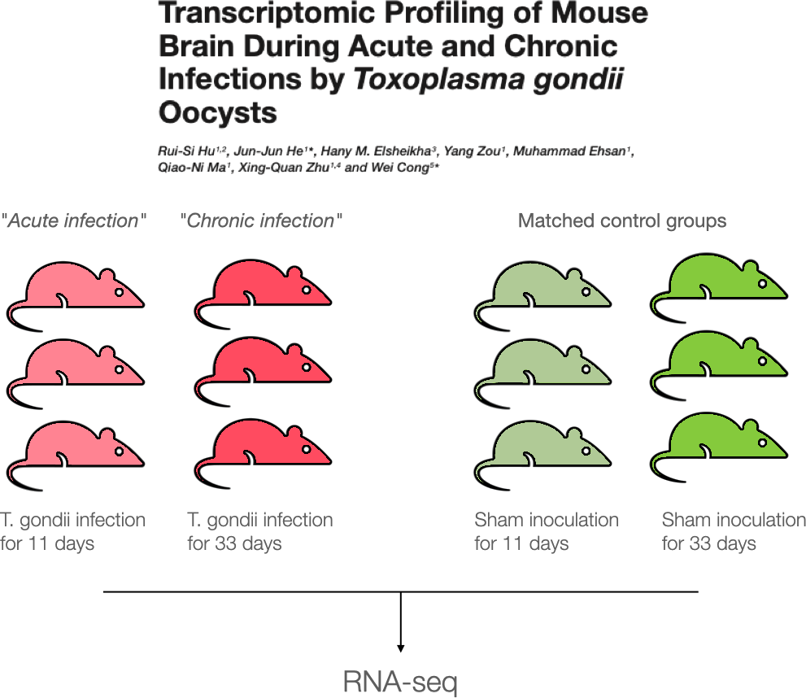
Case Study

Slide 3
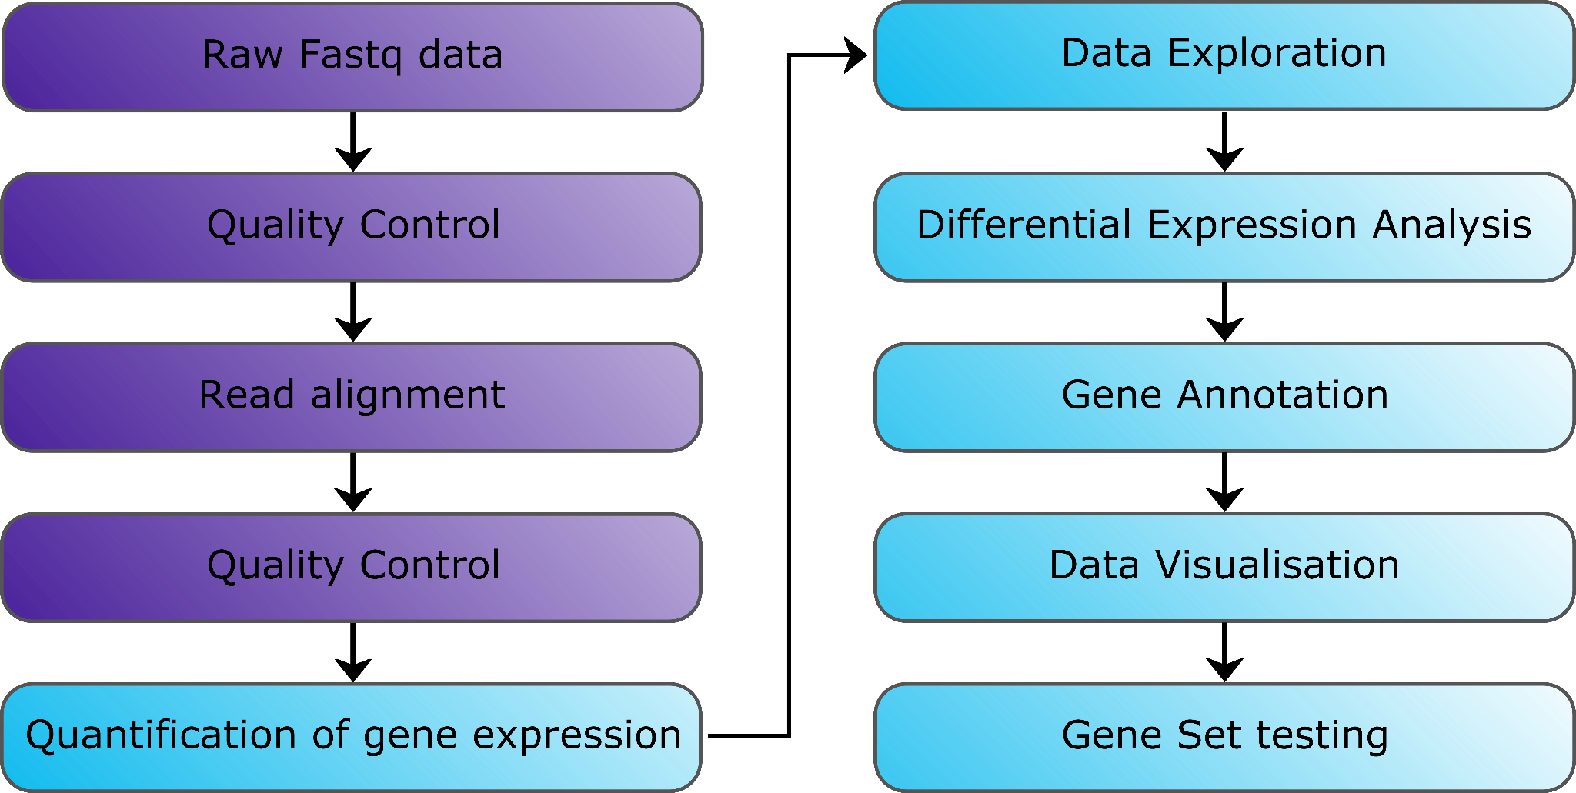
Bioinformatics Analysis Workflow

Slide 4


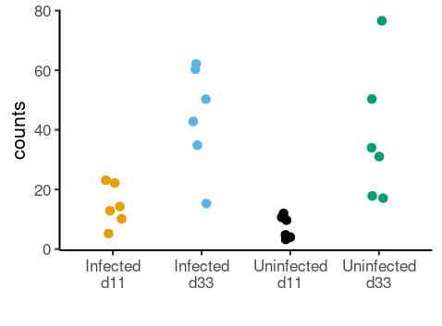
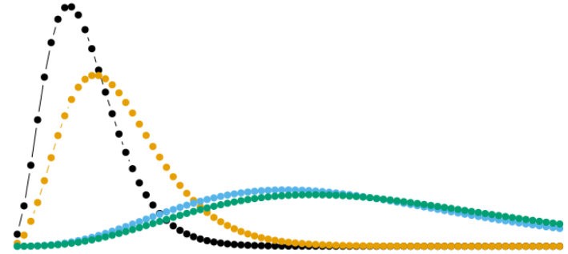
Linear Modelling

Slide 5
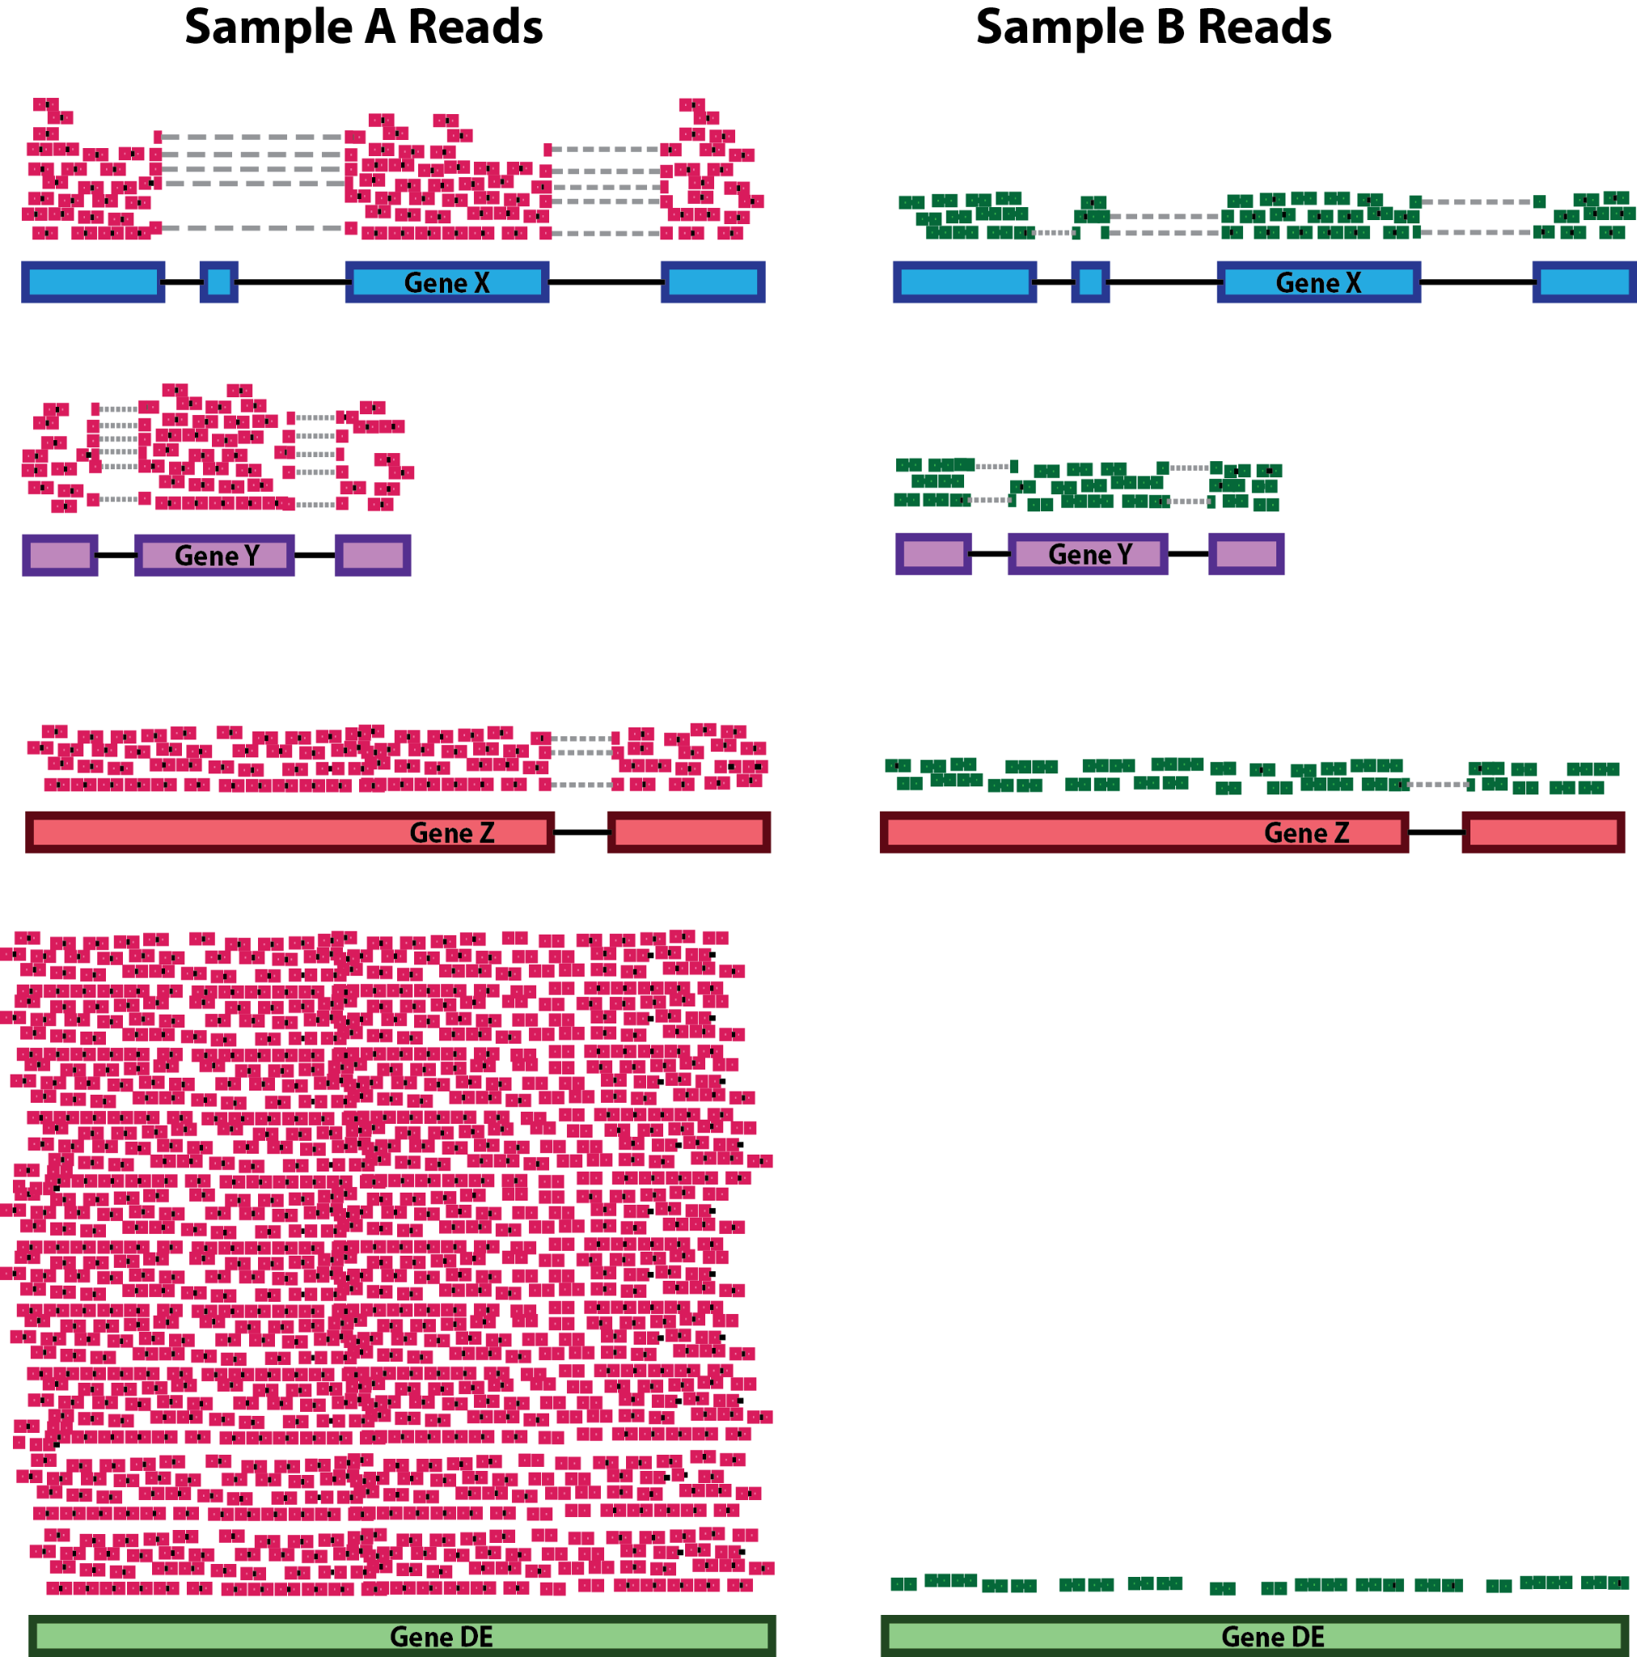
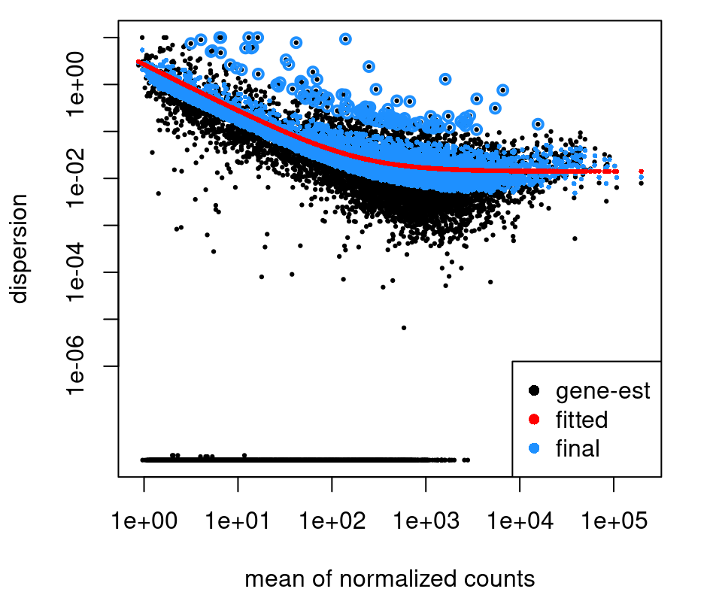
Linear Modelling
Sample Scaling Factors
Gene Dispersion

Slide 6
DESeq2 | Models and Hypothesis Testing | One-Factor Model
Formula syntax:
~ Status
Null hypothesis:
Infected vs Uninfected
𝛽₁ = 0
𝛽₁
𝛽₀
Un
In

Slide 7
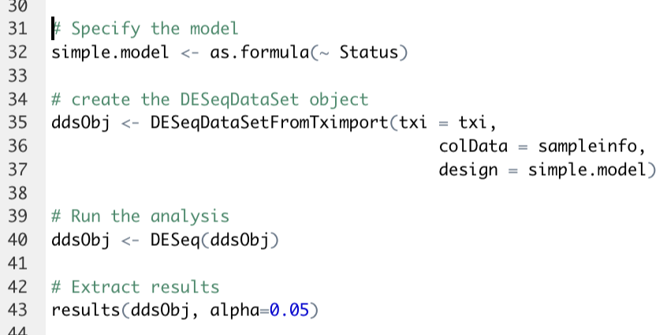
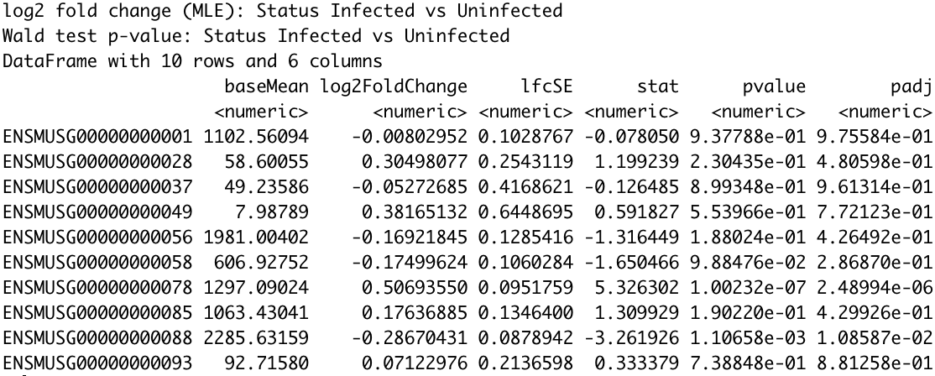
DESeq2 - Defining Models and Hypothesis Testing
Formula syntax:
~ Status
Null hypothesis:
Infected vs Uninfected
𝛽₁ = 0
𝛽₁
𝛽₀
Un
In

Slide 8
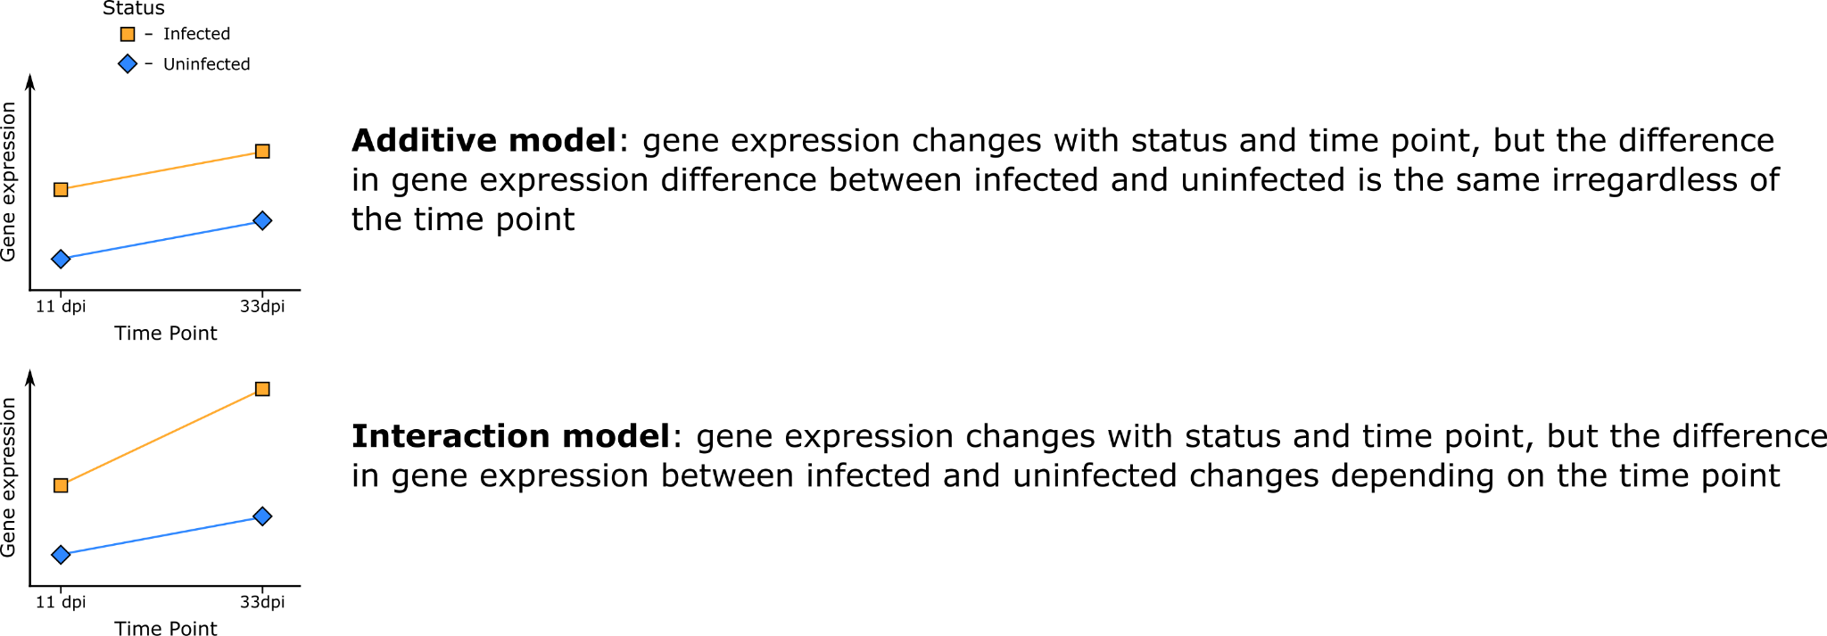
Two Factor Models

Slide 9
DESeq2 | Models and Hypothesis Testing | Two-Factor Additive Model
Formula syntax:
~ Status + TimePoint
DESeq coefficient names:
𝛽₀ → Intercept
𝛽₁ → Status_Infected_vs_Uninfected
𝛽₂ → TimePoint_d33_vs_d11
Null hypothesis:
Infected vs Uninfected
𝛽₁ = 0
d33 vs d11
𝛽₂ = 0
𝛽₁
𝛽₁
𝛽₂
𝛽₂
𝛽₀
Un
d11
In
d11
Un
d33
In
d33

Slide 10
DESeq2 | Models and Hypothesis Testing | Two-Factor Interaction Model
Formula syntax:
~ Status + TimePoint + Status:TimePoint
~ Status * TimePoint
Null hypothesis:
Infected vs Uninfected (d11)
𝛽₁ = 0
Infected vs Uninfected (d33)
𝛽₁ + 𝛽₃ = 0
d33 vs d11 (Uninfected)
𝛽₂ = 0
d33 vs d11 (Infected)
𝛽₂ + 𝛽₃ = 0
Interaction (“Difference of differences”)
𝛽₃ = 0
𝛽₃
𝛽₁
𝛽₁
𝛽₂
𝛽₂
𝛽₀
Un
d11
In
d11
Un
d33
In
d33

Slide 11
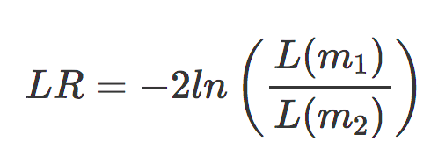
Model Specification in DESeq2 | Likelihood-ratio Test
The default test in DESeq2 is the Wald test, testing for null hypothesis that LFC = 0
And alternative is the Likelihood Ratio Test
~ genotype + timepoint + genotype:timepoint vs ~ genotype + timepoint
Example:
design(dds) ← ~ genotype + timepoint + genotype:timepoint
dds ← DESeq(dds, test = “LRT”,
reduced = ~ genotype)

